Slide 1
AI POWERED CODE REVIEVER AND QUALITY ASSISTANT
Presented by : K.Elaiyaperumal

Slide 2
PROBLEM STATEMENT:
Manual code reviews are time-consuming
Code quality depends on reviewer experience
Inconsistent coding standards
Hard to track maintainability
Need an automated intelligent solution for consistent code review.

Slide 3
PROJECT OBJECTIVE:
Automate code review process
Detect code smells & complexity issues
Improve maintainability and readability
Provide AI-based suggestions
Reduce manual effort

Slide 4
PROPOSED SOLUTION:
Developed an AI-powered system that:
Analyzes Python projects
Calculates Maintainability Index
Detects code smells
Suggests improvements using LLM
Generates auto-fix recommendations

Slide 5
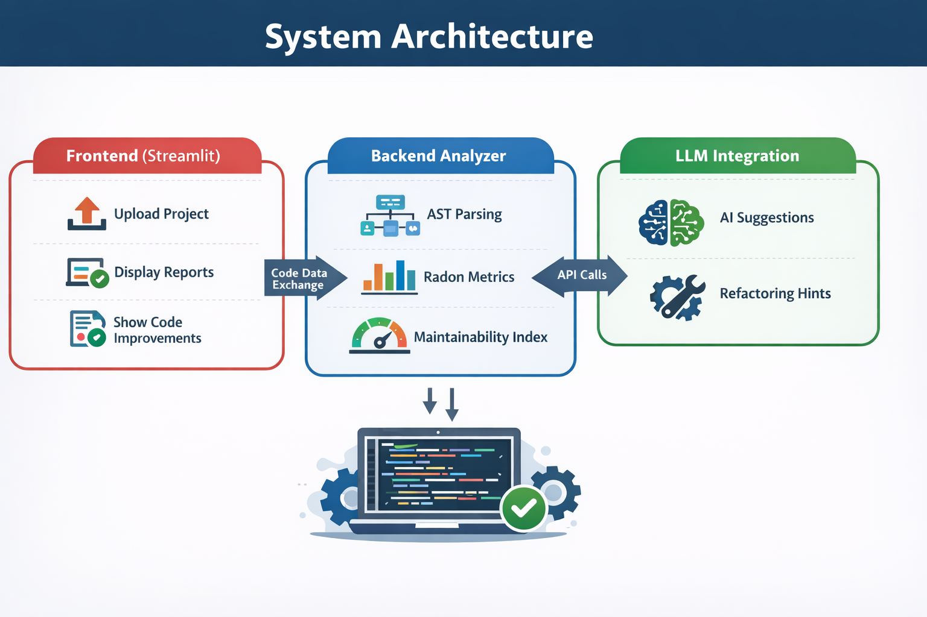
SYSTEM ARCHITECTURE:

Slide 6
TECHNOLOGIES USED:
Python
Streamlit – UI Development
Radon – Code metrics
AST Module – Code parsing
Pandas – Report generation
LLM Model (Ollama Pi3,Router,Google Gemini)

Slide 7
KEY FEATURES:
Maintainability Index calculation
Cyclomatic Complexity detection
Long function detection
Unused imports detection
Naming convention validation
Auto-fix suggestion
Git hook integration

Slide 8
MAINTAINABILITY INDEX:
Maintainability Index (MI) measures how easy code is to maintain.
Formula uses:
Cyclomatic Complexity
Lines of Code
Halstead Volume
Interpretation:
85–100 → Highly Maintainable
65–84 → Moderate
Below 65 → Poor Maintainability

Slide 9
CODE ANALYSIS WORKFLOW:
Upload project
Extract Python files
Parse using AST
Calculate complexity
Compute Maintainability Index
Detect code smells
Generate AI suggestions
Display report

Slide 10
ADVANTAGES OF PROJECT:
Saves review time
Standardized code quality
Beginner-friendly feedback
Improves maintainability
Scalable for teams

Slide 11
RESULTS & PERFORMANCE:
Reduced manual review time
Improved maintainability score
Automatic detection of major code smells
Faster debugging support

Slide 12
CONCLUSION:
The AI-Powered Code Reviewer:
Automates code quality checking
Provides intelligent suggestions
Improves maintainability
Reduces development effort

Slide 13
THANK YOU

